Slide 1
Teleco Customer Churn: Power BI Report
Who leaves, why they leave, and what it costs
Notes:
Introduce the project: a Power BI analysis of the Telco customer churn dataset from Kaggle.

Slide 2
The business problem
7,043
1,869
26.54%
$139K
customers in the dataset
customers churned
overall churn rate
monthly revenue churned
Objective: find which customer groups churn most, what drives it, and which retention actions to prioritize.
Notes:
Churn is costly in telecom: lost revenue, higher acquisition cost and lower lifetime value.

Slide 3
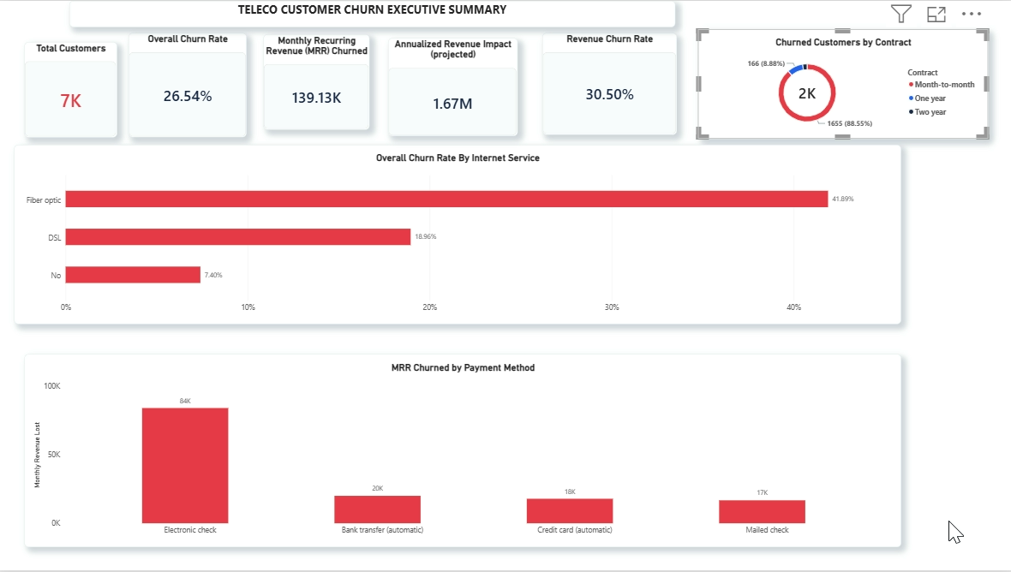
Executive overview (page 1)
26.54% of customers churned
Fiber optic is the riskiest service (41.89%)
Electronic check: $84K of $139K MRR lost
Notes:
Page 1 of the report: headline KPIs, churn by contract, churn rate by internet service, and MRR churned by payment method.

Slide 4
Revenue impact
$139,130.85
MRR churned (monthly)
30.5%
of $456,116.60 total MRR
$1.67M
annualized impact (projected)
Annualized = MRR churned × 12, assuming no replacement customers.
Notes:
State the assumption clearly: this is a projection of recurring revenue at risk, not revenue already collected.

Slide 5
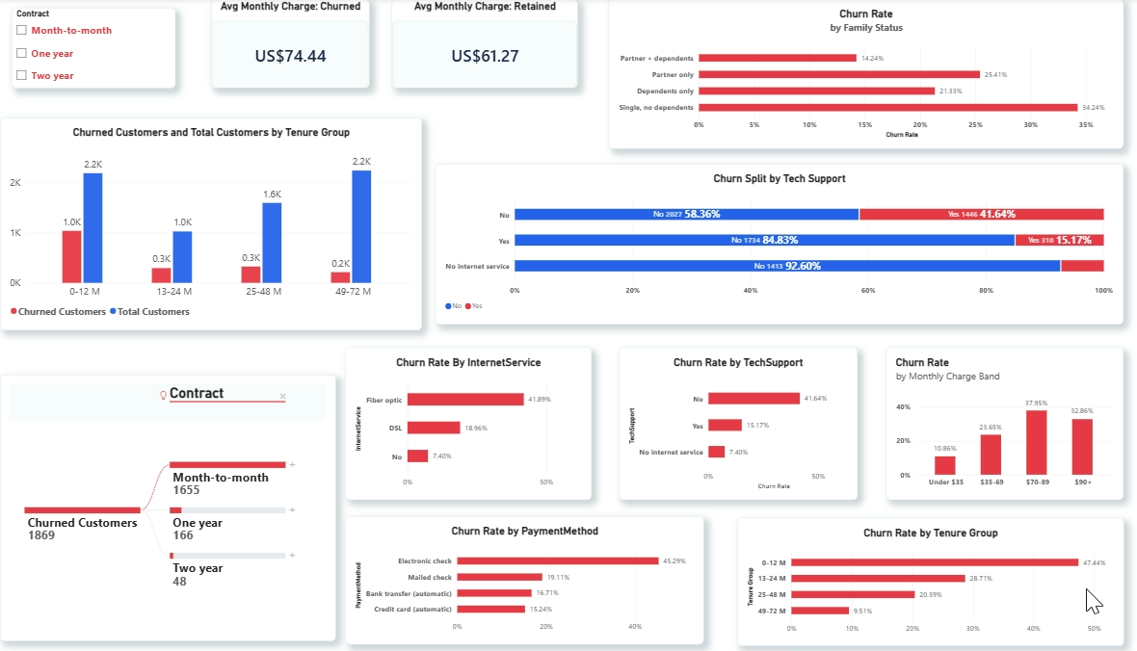
Risk drivers (page 2)
Month-to-month: 1,655 of 1,869 churned
Churn falls from 47.4% to 9.5% with tenure
Single customers churn at 34.2%
Notes:
Page 2: contract decomposition tree, churn by service, payment method, tenure, price band and family status.

Slide 6
Who churns most
41.89%
Fiber optic churn (DSL 18.96%)
45.29%
Electronic check churn
41.64%
No tech support (with support 15.17%)
Notes:
Contract type is the strongest driver. Fiber optic, electronic check and missing tech support compound the risk.

Slide 7
Tenure and price
$74.44
$61.27
Avg bill, churned
Avg bill, retained
Churn peaks at 37.95% for customers paying $70-89 a month, and eases to 32.86% above $90.
Notes:
Early tenure is the vulnerable period. Churned customers pay about $13 more per month on average.

Slide 8
Family status
34.24%
Single customers with no dependents
2.4x
their churn rate vs partner + dependents (14.24%)
Single customers are the group to target.
Notes:
Family status groups: partner + dependents, partner only, dependents only, single with no dependents.

Slide 9
Recommendations
1
Fiber optic support bundle
2
First-year onboarding
Package tech support and security into fiber plans.
Check in at 30, 60 and 90 days; first-year churn is 47%.
3
Autopay incentive
4
Contract conversion
Offer a $5-10 credit to move customers off electronic check.
Discount term contracts for month-to-month customers early.
Notes:
These come from the original analysis and map directly to the four risk drivers.

Slide 10
Limits and next steps
Revenue impact is a projection, not collected revenue
1
Explore why month-to-month customers leave
2
Add context: pricing changes or market events
3
Publish screenshots and a demo video to my portfolio
4
Notes:
Be upfront about the revenue assumption and say what comes next.

